Slide 1
Types of Logical Circuits

Slide 2
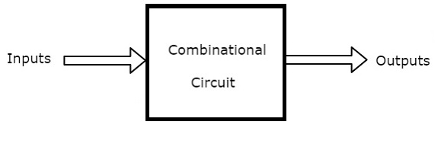
Combinational Circuits
→ Circuits whose present output depends on Present Input only
→ No feedback present
→ Examples: Adder circuits, subtractor circuits

Slide 3
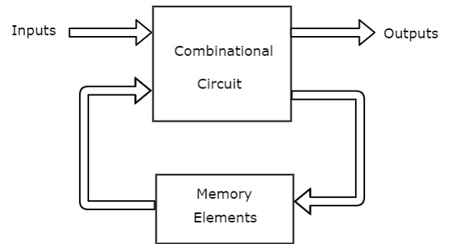
Sequential Circuits
→ Circuits whose present output depends on Present Input + Past output
→ There exist feedback
→ Possess memory
→ Examples: Flipflops, counters, shift registers

Slide 4
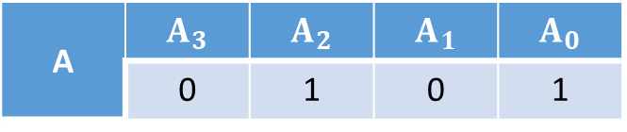
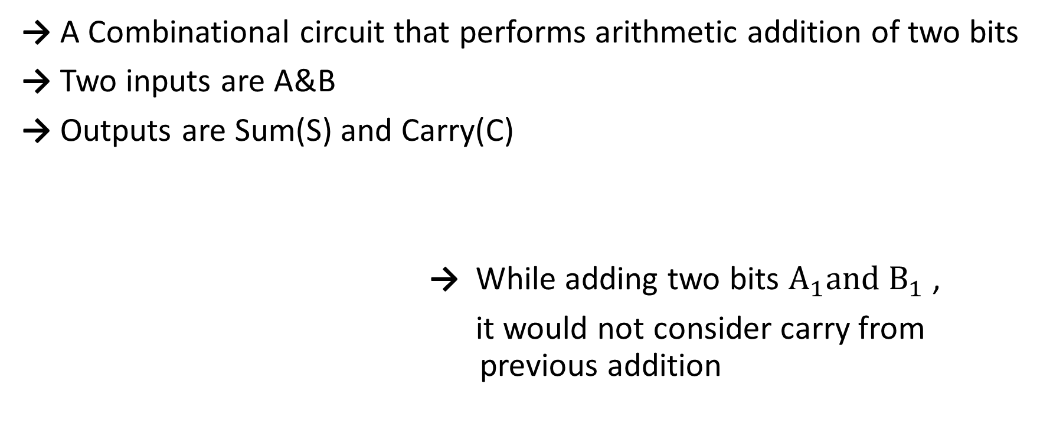
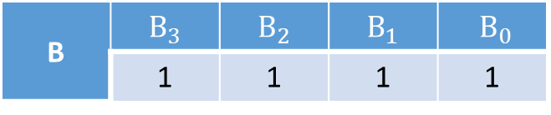
Half Adder
→ A Combinational circuit that performs arithmetic addition of two bits
→ Two inputs are A&B
→ Outputs are Sum(S) and Carry(C)
→ While adding two bits $A_{1}and B_{1}$ ,
it would not consider carry from previous addition
A | $$A_{3}$$ | $$A_{2}$$ | $$A_{1}$$ | $$A_{0}$$
 | 0 | 1 | 0 | 1
B | $$B_{3}$$ | $$B_{2}$$ | $B_{1}$ | $B_{0}$
 | 1 | 1 | 1 | 1

Slide 5

SUM= $\overline{A}$B + A$\overline{B}$ = A⊕B
CARRY= AB
.
INPUTS |  | OUTPUTS
A | B | SUM(S) | CARRY(C)
0 | 0 | 0 | 0
0 | 1 | 1 | 0
1 | 0 | 1 | 0
1 | 1 | 0 | 1

Slide 6
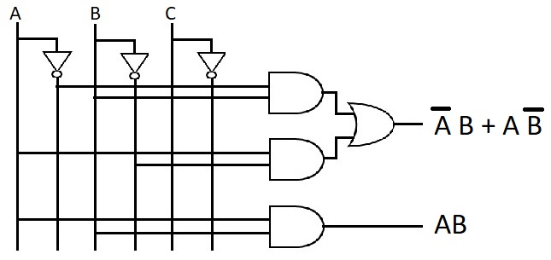
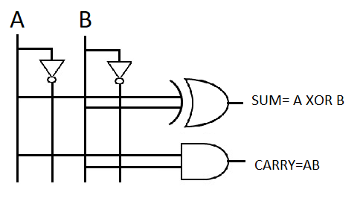
Implementation
Using Basic Gates Using XOR gate

Slide 7
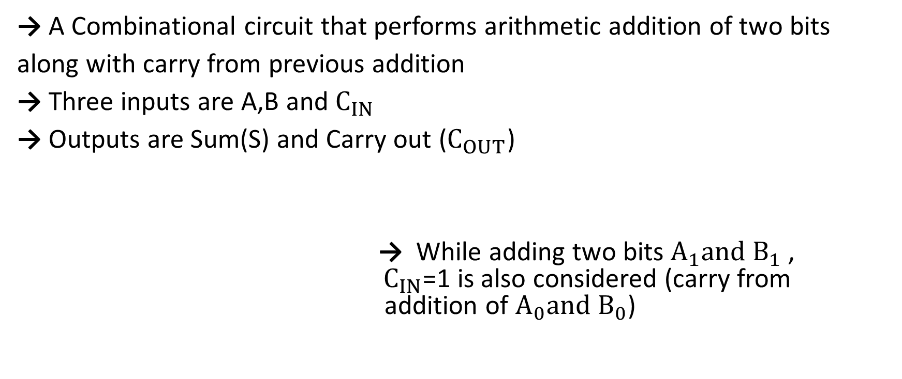
Full Adder
→ A Combinational circuit that performs arithmetic addition of two bits
along with carry from previous addition
→ Three inputs are A,B and $C_{IN}$
→ Outputs are Sum(S) and Carry out ($C_{OUT}$)
→ While adding two bits $A_{1}and B_{1}$ , ${ C}_{IN}$=1 is also considered (carry from addition of $A_{0}and B_{0}$)
A | $$A_{3}$$ | $$A_{2}$$ | $$A_{1}$$ | $$A_{0}$$
 | 0 | 1 | 0 | 1
B | $$B_{3}$$ | $$B_{2}$$ | $B_{1}$ | $B_{0}$
 | 1 | 1 | 1 | 1

Slide 8
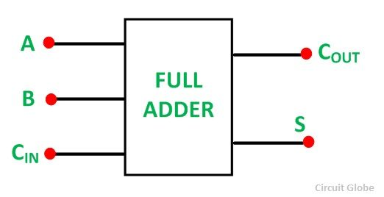
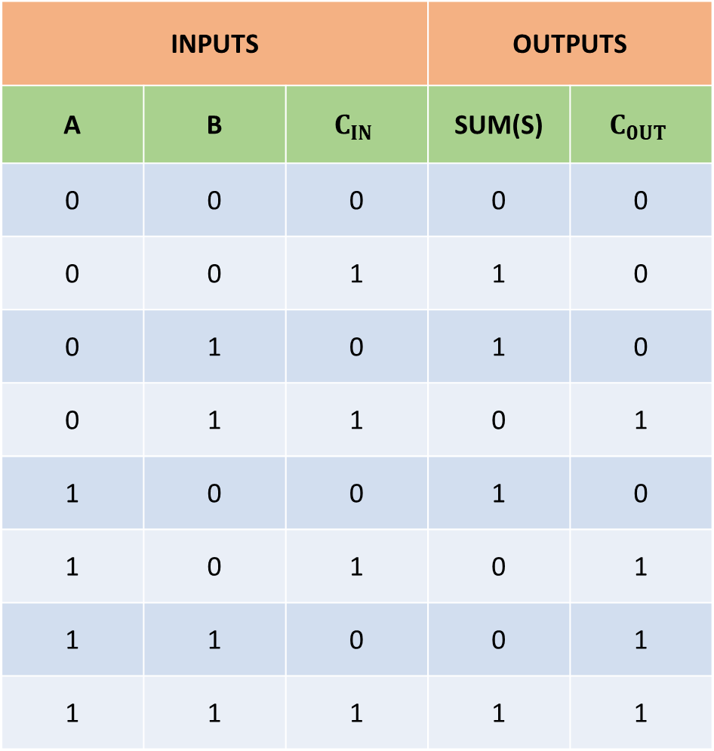
.
INPUTS |  |  | OUTPUTS
A | B | $$C_{IN}$$ | SUM(S) | $$C_{0UT}$$
0 | 0 | 0 | 0 | 0
0 | 0 | 1 | 1 | 0
0 | 1 | 0 | 1 | 0
0 | 1 | 1 | 0 | 1
1 | 0 | 0 | 1 | 0
1 | 0 | 1 | 0 | 1
1 | 1 | 0 | 0 | 1
1 | 1 | 1 | 1 | 1

Slide 9
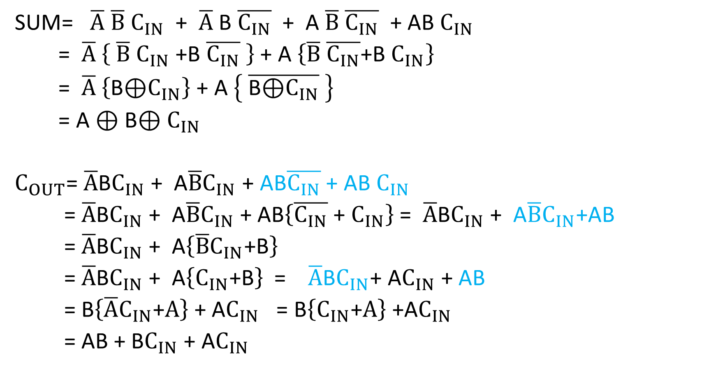
SUM= $\overline{A}$ $\overline{B}$ $C_{IN}$ + $\overline{A}$ B $\overline{C_{IN}}$ + A $\overline{B}$ $\overline{C_{IN}}$ + AB $C_{IN}$
= $\overline{A}$ $\left\{ \overline{B} C_{IN}\text{ +}\text{B} \overline{C_{IN}} \right\}$+ A $\left\{\overline{B} \overline{C_{IN}}\text{+}\text{B} C_{IN}\right\}$
= $\overline{A}$ $\left\{\text{B}\text{⊕}C_{IN}\right\}$+ A $\left\{ \overline{\text{B}\text{⊕}C_{IN}} \right\}$
= A $\text{⊕} \text{B}\text{⊕}{ C}_{IN}$
$C_{OUT}$= $\overline{A}$B$C_{IN}$ + A$\overline{B}C_{IN}$+ AB$\overline{C_{IN}}$ + AB $C_{IN}$
= $\overline{A}$B$C_{IN}$ + A$\overline{B}C_{IN}$ + AB$\left\{\overline{C_{IN}}\text{ + }C_{IN}\right\}$ = $\overline{A}$B$C_{IN}$ + A$\overline{B}C_{IN}$+AB
= $\overline{A}$B$C_{IN}$ + A$\left\{\overline{B}C_{IN}\text{+}\text{B}\right\}$
= $\overline{A}$B$C_{IN}$ + A$\left\{C_{IN}\text{+}\text{B}\right\}$ = $\overline{A}$B$C_{IN}$+ A$C_{IN}$ + AB
= B$\left\{\overline{A}C_{IN}\text{+}A\right\}$ + A$C_{IN}$ = B$\left\{C_{IN}\text{+}A\right\}$ +A$C_{IN}$
= AB + B$C_{IN}$ + A$C_{IN}$

Slide 10
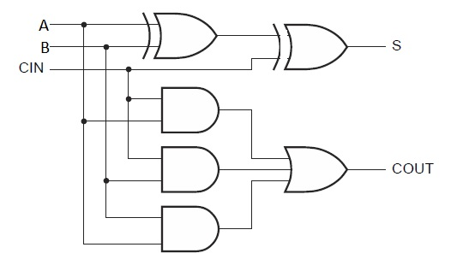
Implementation

Slide 11
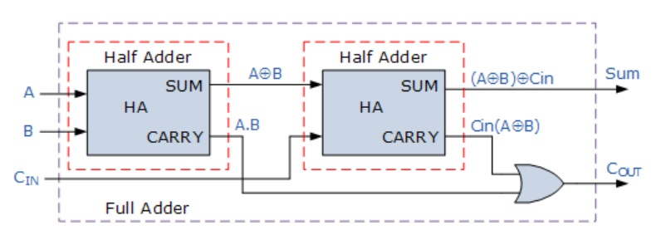
Full adder using 2 HA and an additional gate

Slide 12
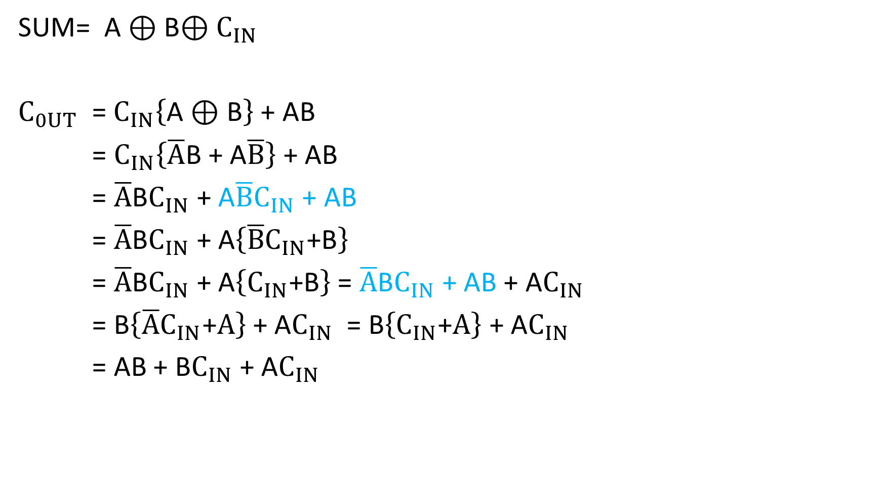
SUM= A $\text{⊕} \text{B}\text{⊕}{ C}_{IN}$
$C_{0UT}$ = $C_{IN}\left\{\text{A}\text{ ⊕} \text{B}\right\}$ + AB
= $C_{IN}\left\{\overline{A}\text{B}\text{ + }\text{A}\overline{B}\right\}$ + AB
= $\overline{A}\text{B}C_{IN}$+ $\text{A}\overline{B}C_{IN}$ + AB
= $\overline{A}\text{B}C_{IN}$+ $\text{A}\left\{\overline{B}C_{IN}\text{+}\text{B}\right\}$
= $\overline{A}\text{B}C_{IN}$+ $\text{A}\left\{C_{IN}\text{+}\text{B}\right\}$ = $\overline{A}\text{B}C_{IN}$+ $\text{A}\text{B}$ + A$C_{IN}$
= B$\left\{\overline{A}C_{IN}\text{+}A\right\}$+ A$C_{IN}$ = B$\left\{C_{IN}\text{+}A\right\}$+ A$C_{IN}$
= AB + B$C_{IN}$ + A$C_{IN}$

Slide 13
Exercise
1.Implement a logical circuit to realize HALF SUBTRACTOR
Hint: Similar to HALF ADDER, Borrow is not considered
2.Implement a logical circuit to real FULL SUBTRACTOR
Hint: Similar to FULL ADDER, Borrow-in is considered
3.Implement FULL ADDER using basic gates

Slide 14
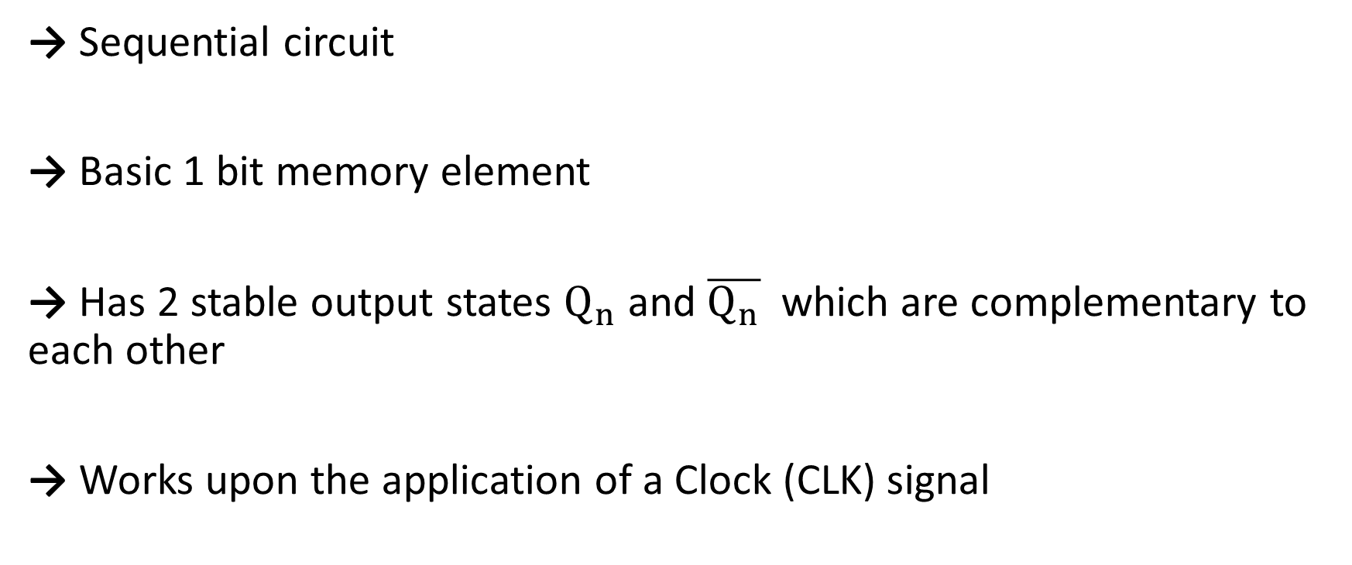
FlipFlops
→ Sequential circuit
→ Basic 1 bit memory element
→ Has 2 stable output states $Q_{n}$ and $\overline{Q_{n}}$ which are complementary to each other
→ Works upon the application of a Clock (CLK) signal

Slide 15

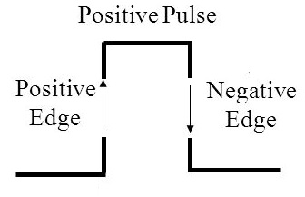
Clock Signal (CLK)
CLK acts as a master control for flip flop working
Clock is usually a square wave/ repetitive train of pulses
One clock pulse Edges and levels of clock
Positive pulses
Positive edges
Negative edges

Slide 16
Two types of triggering/activation:
pulse-triggered
edge-triggered
Pulse-triggered (Level Triggered)
latches
ON = 1, OFF = 0
Edge-triggered
flip-flops
positive edge-triggered (ON = from 0 to 1; OFF = other time)
negative edge-triggered (ON = from 1 to 0; OFF = other time)

Slide 17
SR Flipflop (Set-Reset Flipflop)
D Flipflop (DataLatch Flipflop)
JK Flipflop
T Flipflop (Toggle Flipflop)

Slide 18
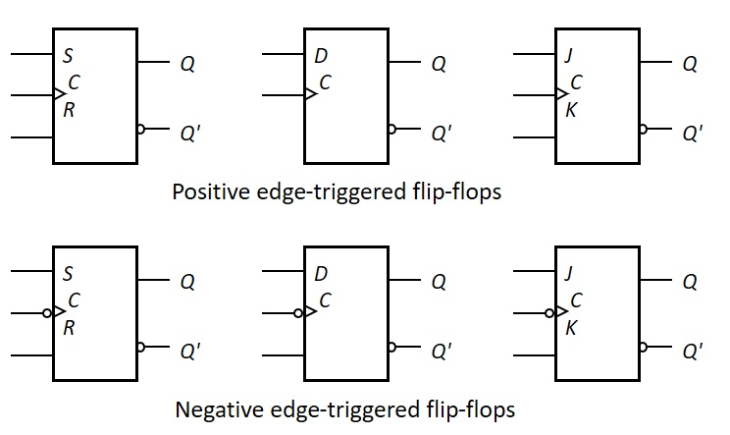
Symbolic Representation of Edge-Triggered Flip-flops
S-R, D and J-K edge-triggered flip-flops. Note the “>” symbol at the clock input.

Slide 19
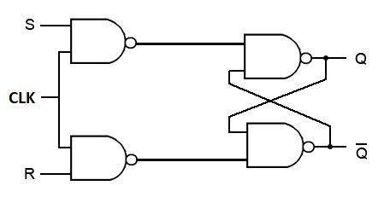

SR Flipflop
Clock input act as a control button
S,R are the 2 inputs
$Q$ , $\overline{Q}$are the outputs
$Q$ , $\overline{Q}$ should always be complementary to each other

Slide 20
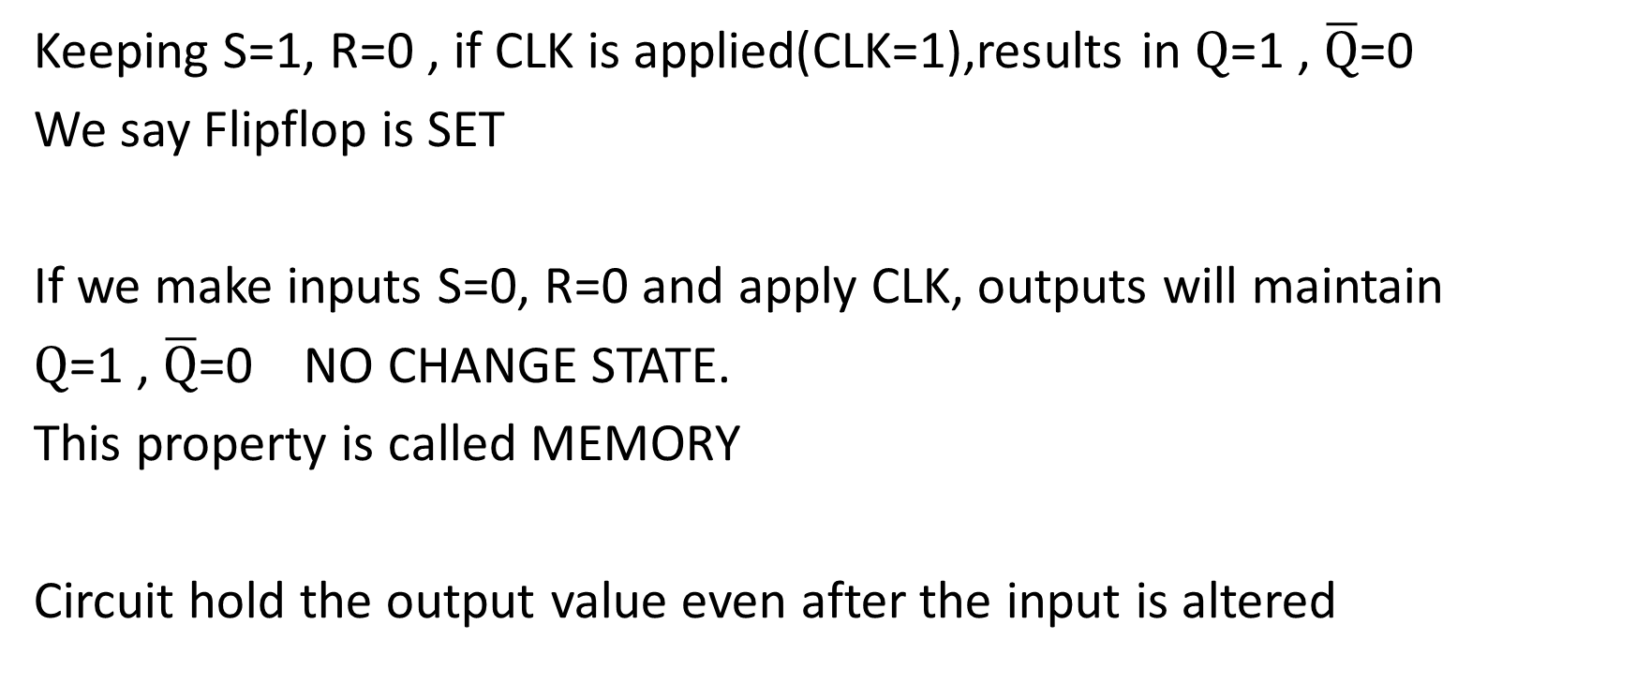
Working of SR Flipflop
Keeping S=1, R=0 , if CLK is applied(CLK=1),results in $Q$=1 , $\overline{Q}$=0
We say Flipflop is SET
If we make inputs S=0, R=0 and apply CLK, outputs will maintain
$Q$=1 , $\overline{Q}$=0 NO CHANGE STATE.
This property is called MEMORY
Circuit hold the output value even after the input is altered

Slide 21
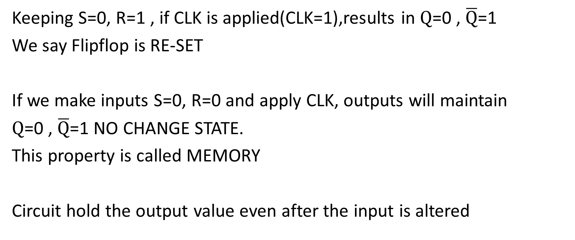
CONTD..
Keeping S=0, R=1 , if CLK is applied(CLK=1),results in $Q$=0 , $\overline{Q}$=1
We say Flipflop is RE-SET
If we make inputs S=0, R=0 and apply CLK, outputs will maintain
$Q$=0 , $\overline{Q}$=1 NO CHANGE STATE.
This property is called MEMORY
Circuit hold the output value even after the input is altered

Slide 22
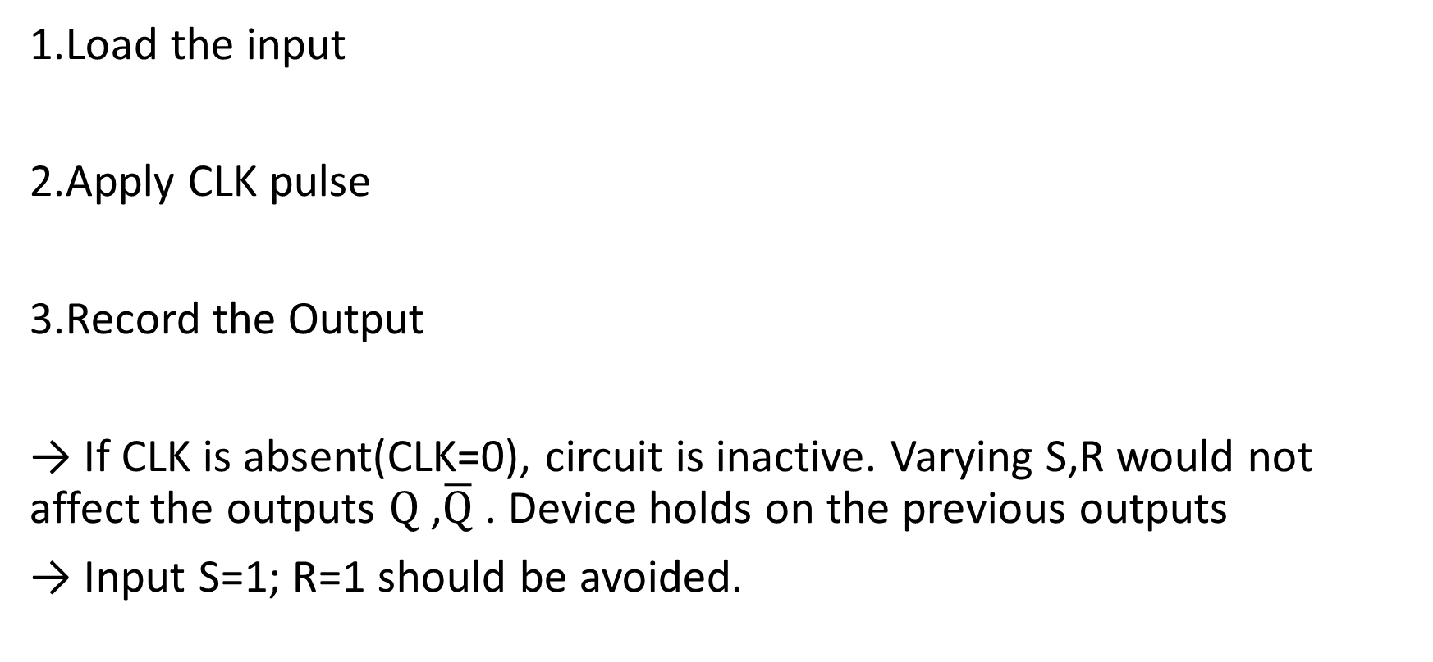
Summary
1.Load the input
2.Apply CLK pulse
3.Record the Output
→ If CLK is absent(CLK=0), circuit is inactive. Varying S,R would not affect the outputs $Q$ ,$\overline{Q}$ . Device holds on the previous outputs
→ Input S=1; R=1 should be avoided.

Slide 23
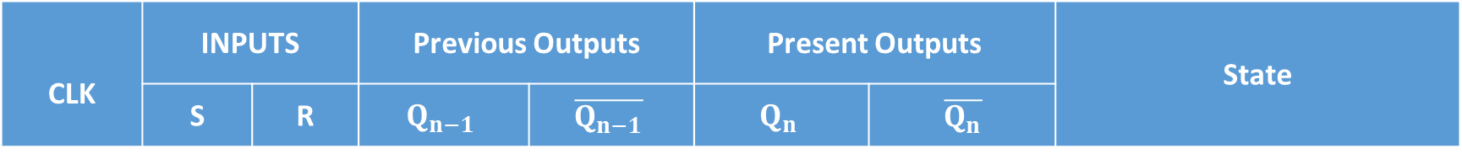
CLK | INPUTS |  | Previous Outputs |  | Present Outputs |  | State
 | S | R | $$Q_{n−1}$$ | $$\overline{Q_{n−1}}$$ | $$Q_{n}$$ | $$\overline{Q_{n}}$$
1 | 0 | 0 | 0 | 1 | 0 | 1 | No change / MEMORY
1 | 0 | 0 | 1 | 0 | 1 | 0
1 | 0 | 1 | 0 | 1 | 0 | 1 | Reset
1 | 0 | 1 | 1 | 0 | 0 | 1
1 | 1 | 0 | 0 | 1 | 1 | 0 | Set
1 | 1 | 0 | 1 | 0 | 1 | 0
1 | 1 | 1 | 0 | 1 | 1 | 1 | Race around/Invalid
1 | 1 | 1 | 1 | 0 | 1 | 1
0 | X | X | 0 | 1 | 0 | 1 | No change
0 | X | X | 1 | 0 | 1 | 0

Slide 25
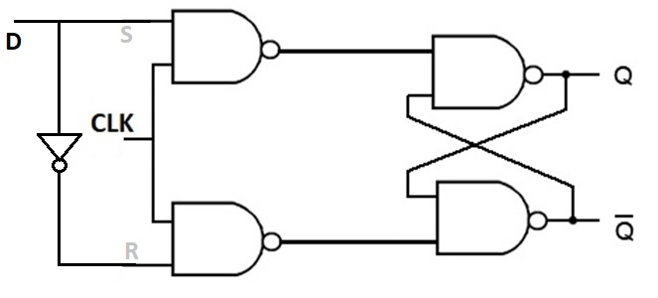

D Flipflop
Avoids the Race-around condition in SR Flipflop.
D is the data latch input ; Clock input act as a control button
$Q$ , $\overline{Q}$are the outputs
$Q$ , $\overline{Q}$ should always be complementary to each other

Slide 26
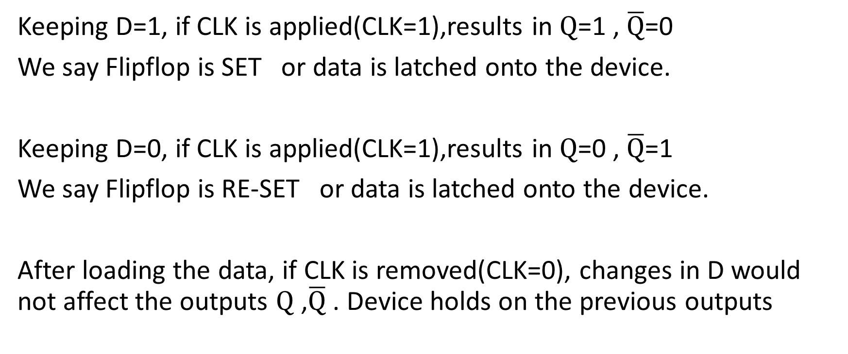
Working of D Flipflop
Keeping D=1, if CLK is applied(CLK=1),results in $Q$=1 , $\overline{Q}$=0
We say Flipflop is SET or data is latched onto the device.
Keeping D=0, if CLK is applied(CLK=1),results in $Q$=0 , $\overline{Q}$=1
We say Flipflop is RE-SET or data is latched onto the device.
After loading the data, if CLK is removed(CLK=0), changes in D would not affect the outputs $Q$ ,$\overline{Q}$ . Device holds on the previous outputs

Slide 27
Summary
1.Load the input
2.Apply CLK pulse
3.Record the Output
→ There is no Race-around condition.

Slide 28
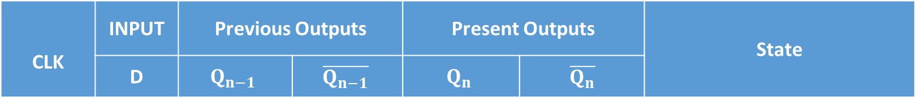
CLK | INPUT | Previous Outputs |  | Present Outputs |  | State
 | D | $$Q_{n−1}$$ | $$\overline{Q_{n−1}}$$ | $$Q_{n}$$ | $$\overline{Q_{n}}$$
1 | 1 | 0 | 1 | 1 | 0 | SET
1 | 1 | 1 | 0 | 1 | 0
1 | 0 | 0 | 1 | 0 | 1 | RESET
1 | 0 | 1 | 0 | 0 | 1
0 | X | 0 | 1 | 0 | 1 | NO CHANGE
0 | X | 1 | 0 | 1 | 0

Slide 30
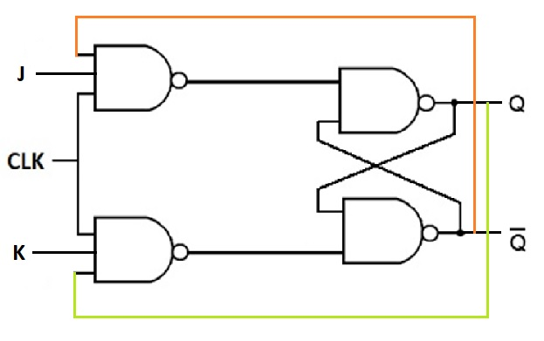
JK Flipflop
Clock input act as a control button
J,K are the 2 inputs
Working is same as that of SR except when J=1, K=1; output toggles

Slide 31
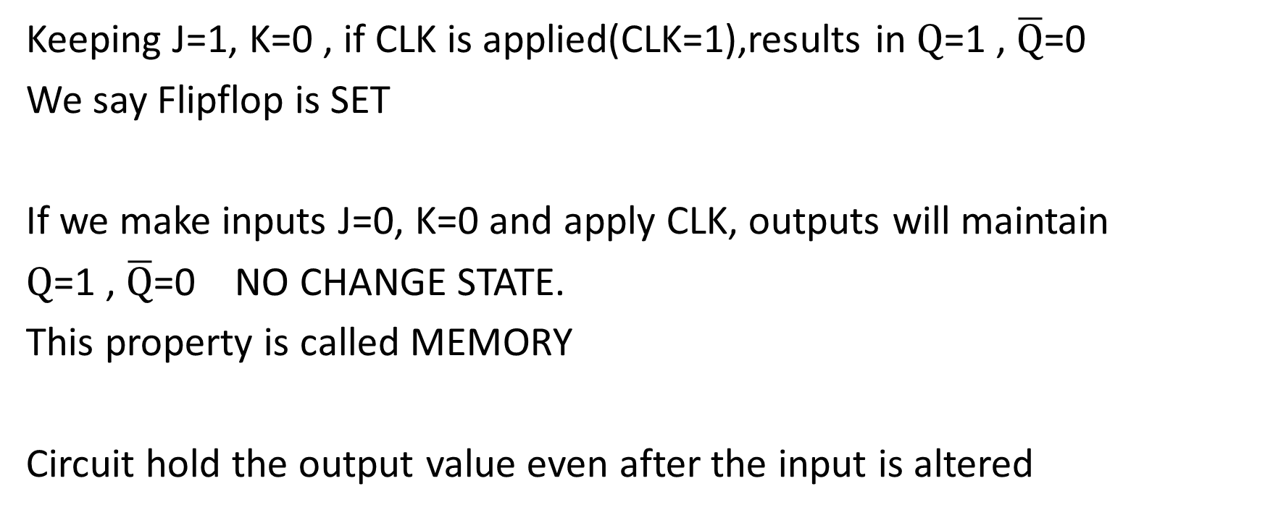
Working of JK Flipflop
Keeping J=1, K=0 , if CLK is applied(CLK=1),results in $Q$=1 , $\overline{Q}$=0
We say Flipflop is SET
If we make inputs J=0, K=0 and apply CLK, outputs will maintain
$Q$=1 , $\overline{Q}$=0 NO CHANGE STATE.
This property is called MEMORY
Circuit hold the output value even after the input is altered

Slide 32
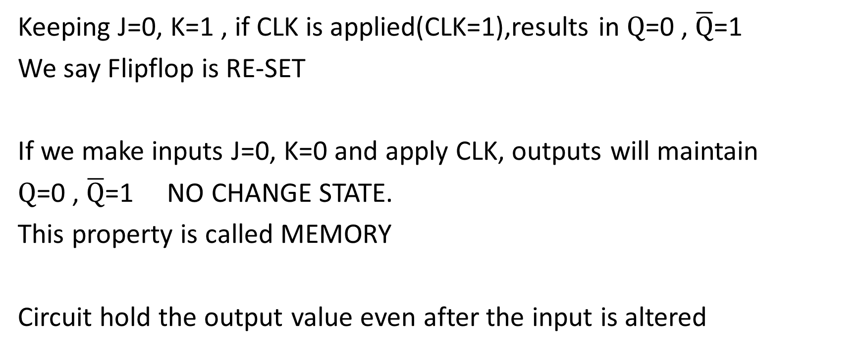
CONTD..
Keeping J=0, K=1 , if CLK is applied(CLK=1),results in $Q$=0 , $\overline{Q}$=1
We say Flipflop is RE-SET
If we make inputs J=0, K=0 and apply CLK, outputs will maintain
$Q$=0 , $\overline{Q}$=1 NO CHANGE STATE.
This property is called MEMORY
Circuit hold the output value even after the input is altered

Slide 33
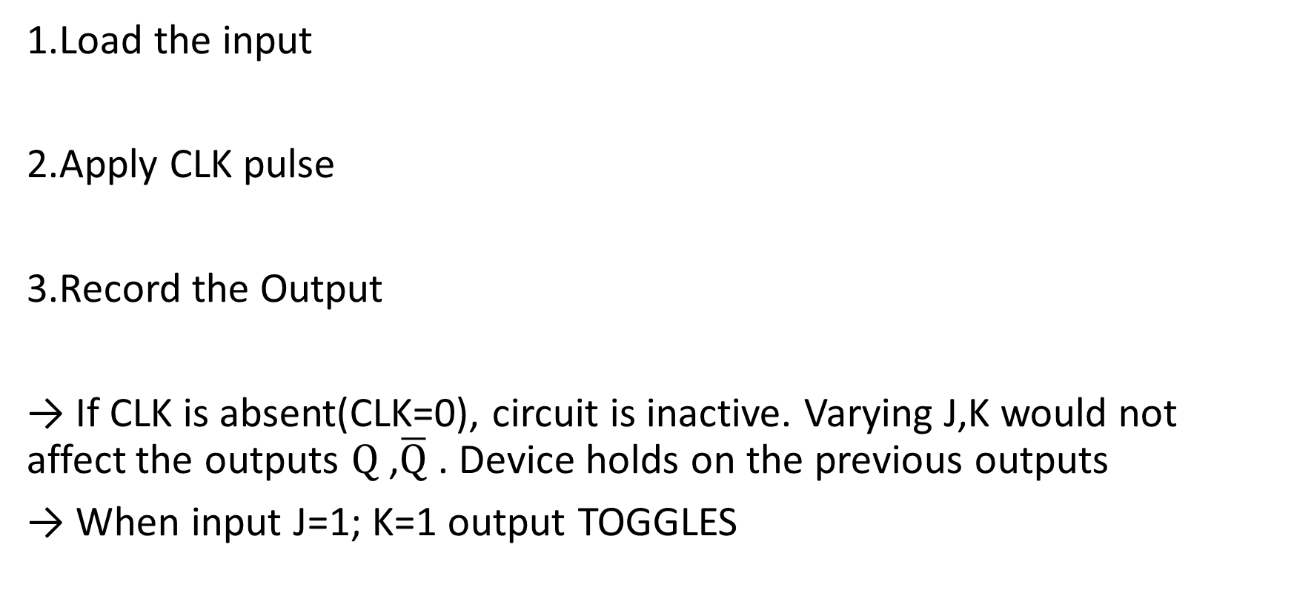
Overall Working
1.Load the input
2.Apply CLK pulse
3.Record the Output
→ If CLK is absent(CLK=0), circuit is inactive. Varying J,K would not affect the outputs $Q$ ,$\overline{Q}$ . Device holds on the previous outputs
→ When input J=1; K=1 output TOGGLES

Slide 34
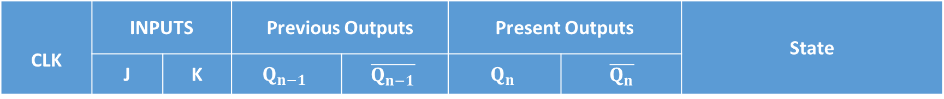
CLK | INPUTS |  | Previous Outputs |  | Present Outputs |  | State
 | J | K | $$Q_{n−1}$$ | $$\overline{Q_{n−1}}$$ | $$Q_{n}$$ | $$\overline{Q_{n}}$$
1 | 0 | 0 | 0 | 1 | 0 | 1 | No change / MEMORY
1 | 0 | 0 | 1 | 0 | 1 | 0
1 | 0 | 1 | 0 | 1 | 0 | 1 | Reset
1 | 0 | 1 | 1 | 0 | 0 | 1
1 | 1 | 0 | 0 | 1 | 1 | 0 | Set
1 | 1 | 0 | 1 | 0 | 1 | 0
1 | 1 | 1 | 0 | 1 | 1 | 0 | Toggle
1 | 1 | 1 | 1 | 0 | 0 | 1
0 | X | X | 0 | 1 | 0 | 1 | No change
0 | X | X | 1 | 0 | 1 | 0

Slide 36
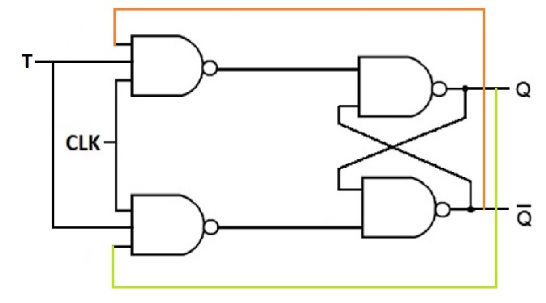
T Flipflop
Modification to JK flipflop.
When T=1 , output TOGGLES upon application of CLK pulse.
When T=0 , Previous state is maintained.
This is useful in designing counters.

Slide 37
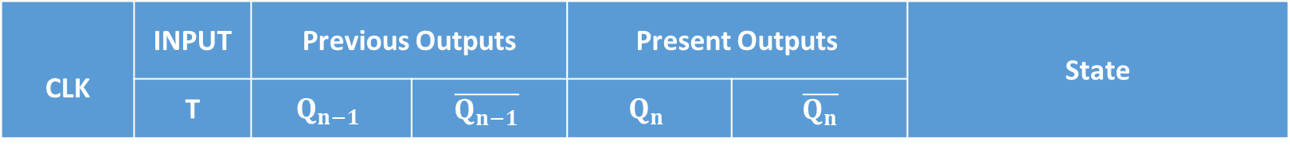
CLK | INPUT | Previous Outputs |  | Present Outputs |  | State
 | T | $$Q_{n−1}$$ | $$\overline{Q_{n−1}}$$ | $$Q_{n}$$ | $$\overline{Q_{n}}$$
1 | 1 | 0 | 1 | 1 | 0 | TOGGLE
1 | 1 | 1 | 0 | 0 | 1
1 | 0 | 0 | 1 | 0 | 1 | No change / MEMORY
1 | 0 | 1 | 0 | 1 | 0
0 | X | 0 | 1 | 0 | 1 | NO CHANGE
0 | X | 1 | 0 | 1 | 0

